Slide 1


Facebook Topic Data
March 2016

Slide 2
Hidden Valley Ranch
How can we emphasize that ranch goes on everything while creating a playful association with ranch?
Open stream of posts from facebook containing mentions of Hidden Valley Ranch
Demographic Analysis
Links/content driving conversation
Customized topic/text analysis
Top foods associated with each holiday
Emotional resonance analysis
15,400
Total Interactions

Slide 3
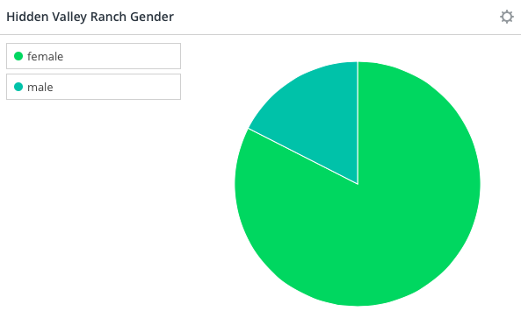
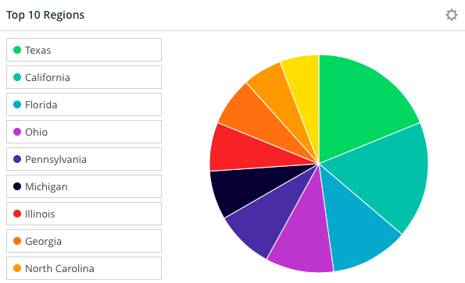
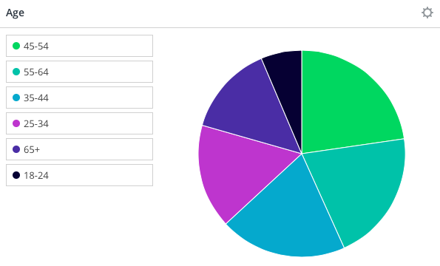
Hidden Valley Ranch- Demographic Analysis

Slide 4
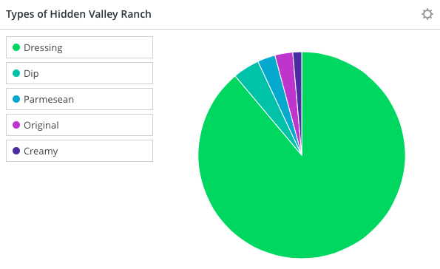
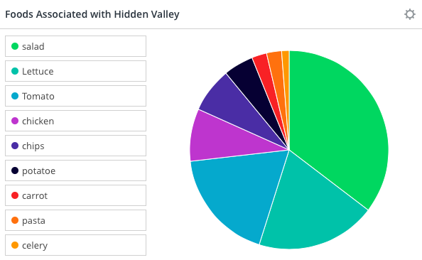
Hidden Valley Ranch- Custom Topic Analysis

Slide 5
Hidden Valley Ranch- Top 3 Links
600 interactions-
http://world-recipes.co/2016/03/seven-layer-salad-2/
400 interactions-
https://www.facebook.com/maria.mcwhinnie
300 interactions-
https://www.facebook.com/bobby.longest.7

Slide 6
National Ranch Day
How can we emphasize that ranch goes on everything while creating a playful association with ranch?
Open stream of posts from facebook containing mentions of National Ranch Day
Demographic Analysis
Links/content driving conversation
Customized topic/text analysis
1,500
Total Interactions

Slide 7
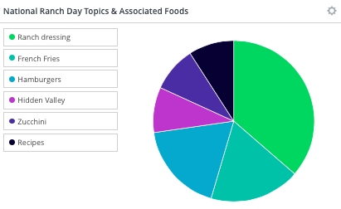
National Ranch Day- Custom Topic Analysis

Slide 8
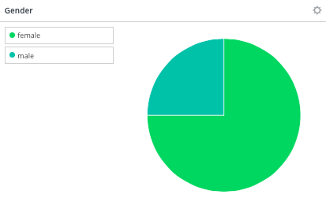
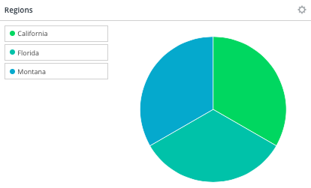
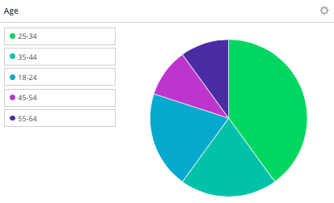
National Ranch Day- Demographic Analysis

Slide 9
National Ranch Day- Top Links
100 interactions-
http://bit.ly/1LVb773
100 interactions-
http://bit.ly/1HUTy4x

Slide 10
Food Holidays
How can we emphasize that ranch goes on everything while creating a playful association with ranch?
Open stream of posts from facebook containing mentions of food holidays
Demographic Analysis
Links/content driving conversation
Customized topic/text analysis
Top foods associated with each holiday
37,600
Total Interactions

Slide 11
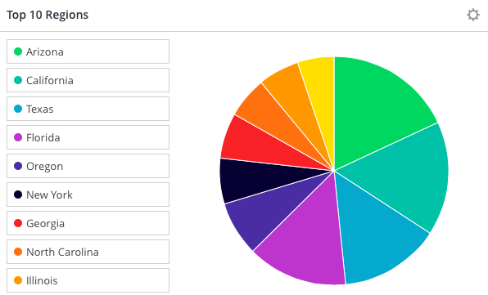
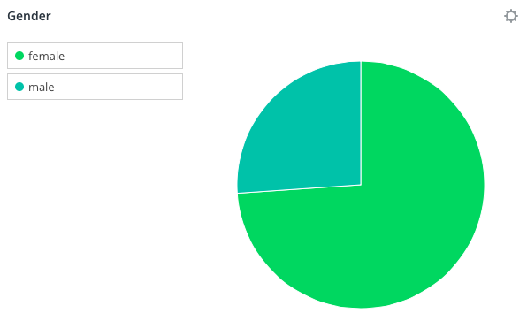
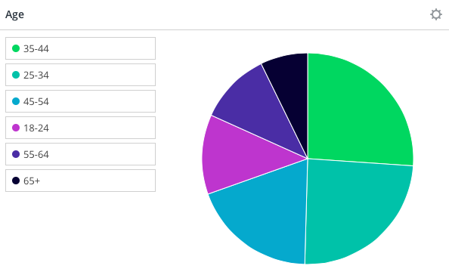
Food Holidays- Demographic Analysis

Slide 12
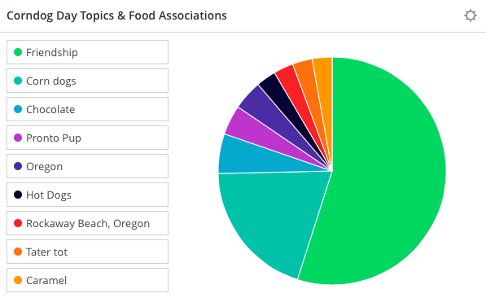
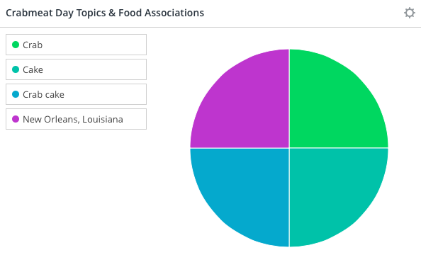
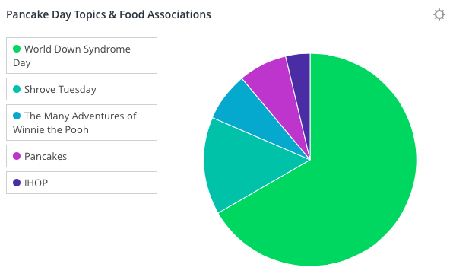
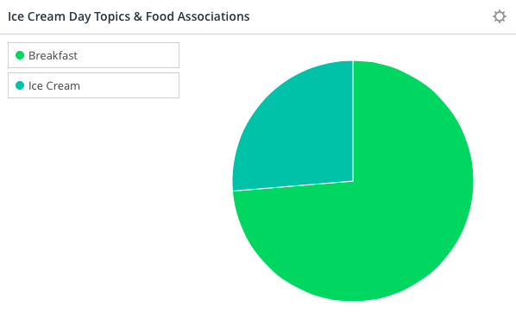
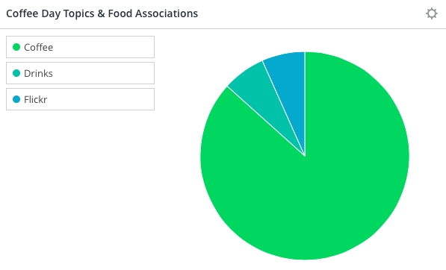
Food Holidays- Custom Topic Analysis

Slide 13
Food Holidays- Top 3 Links
3600 interactions-
http://bit.ly/1Yxm02l
500 interactions-
http://bit.ly/1TMdbCF
400 interactions-
http://bit.ly/1XipIMA

Slide 14
Ketchup
How can we emphasize that ranch goes on everything while creating a playful association with ranch?
Open stream of posts from facebook containing mentions of Ketchup
Demographic Analysis
Links/content driving conversation
Customized topic/text analysis
Top foods associated with Ketchup
Emotional resonance analysis
Brand SOV analysis
493,200
Total Interactions

Slide 15
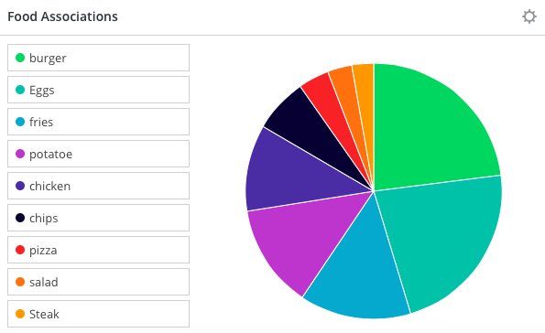
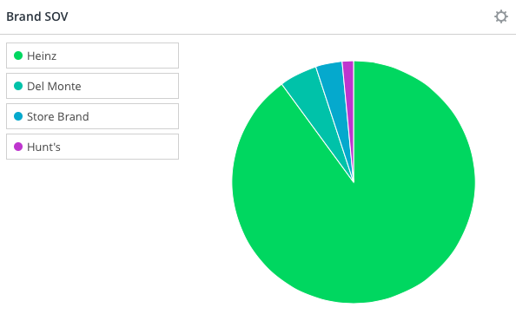
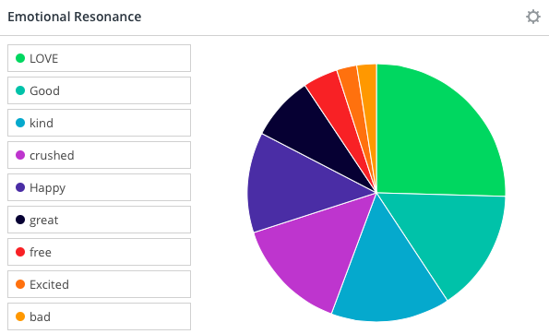
Ketchup- Custom Topic Analysis

Slide 16
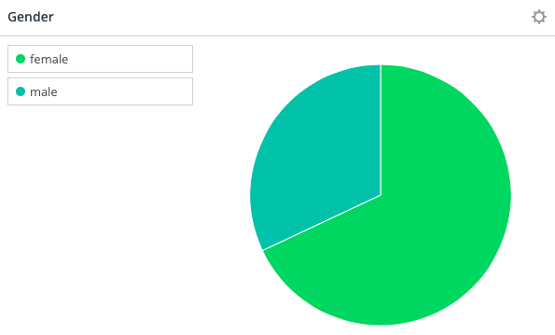
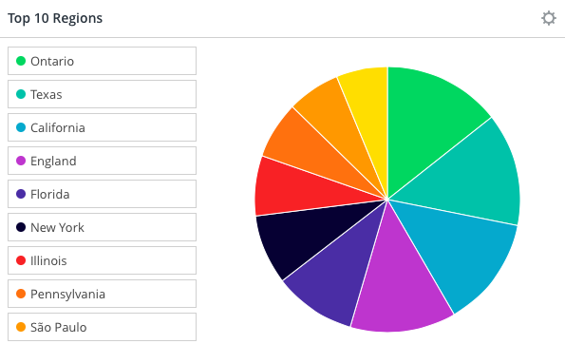
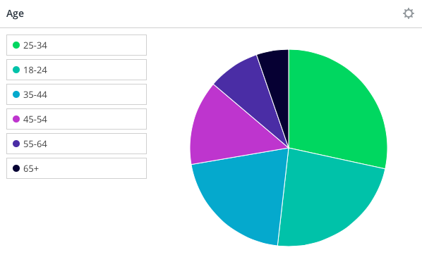
Ketchup- Demographic Analysis

Slide 17
Ketchup- Top 3 Links
14400 interactions-
http://myfridgefood.com/recipes/entree-beef/cheesy-meat-loaf
5100 interactions-https://media.giphy.com/media/5p1w47efxKMHm/giphy.gif
4300 interactions-
http://www.foodtv.com/4f98l

